Slide 1




NEXT GEN EMPLOYABILITY PROGRAM
Creating a future-ready workforce
Team Members
College Name
Student Name :BARATH S
Student ID :422721104007
V.R.S College of Engineering And Techonology

Slide 2

CAPSTONE PROJECT SHOWCASE
Project Title
Car Rentals Application with Django Framework
Abstract | Problem Statement | Project Overview | Proposed Solution | Technology Used | Modelling & Results | Conclusion

Slide 3
Abstract
Our project involves the development of a car rental application using the Django framework. The application provides a user-friendly platform for customers to browse available vehicles, make reservations, and manage bookings. Features include user authentication, dynamic inventory management, integration with payment gateways, and an administrative dashboard for rental agencies to monitor activity and manage resources efficiently. Through the utilization of Django's robust features and scalability, our application aims to streamline the car rental process, enhance customer satisfaction, and optimize rental agency operations.
Source :

Slide 4
Problem Statement
The car rental industry faces efficiency and user experience challenges due to outdated systems lacking user-friendly interfaces, real-time inventory management, and secure payment processing. This project aims to develop a Django-based car rental application to tackle these issues. The application will offer customers a seamless platform to browse, book, and pay for vehicles securely, while providing rental agencies with inventory management tools and booking monitoring capabilities. Leveraging Django's robust features, this solution seeks to streamline the rental process, enhance customer satisfaction, and boost operational efficiency for rental agencies.
Source :

Slide 5
Project Overview
Our project involves developing a car rentals application using Django framework. It will offer customers an intuitive platform to browse, book, and pay for vehicles securely. For rental agencies, it provides inventory management tools and booking monitoring capabilities. By leveraging Django's robust features, our solution aims to streamline the rental process, enhance customer satisfaction, and boost operational efficiency.
Source :

Slide 6
Proposed Solution
Our solution for the car rentals application involves using Django framework to create a user-friendly platform. It includes features like secure user authentication, dynamic inventory management, reservation booking, payment gateway integration, administrative dashboard, and responsive user interface. By leveraging Django's capabilities, our solution aims to streamline the rental process, enhance user experience, and improve operational efficiency for rental agencies.
Source :

Slide 7
Our proposed solution for the car rentals application involves leveraging the Django framework to develop a robust and user-friendly platform. Here's an overview of our approach:
1. *User Authentication and Authorization*: Implement secure user authentication for customers and rental agencies, allowing them to access relevant features based on their roles. This ensures data security and privacy.
2. *Dynamic Inventory Management*: Develop a system for rental agencies to add, update, and manage their vehicle inventory dynamically. This includes features for adding new vehicles, updating availability status, and removing rented vehicles from the inventory.
Source :

Slide 8
3. *Payment Gateway Integration*: Integrate a secure payment gateway to
facilitate online payments for rental bookings. Support multiple payment methods to accommodate customer preferences and ensure seamless transactions.
4. *Administrative Dashboard*: Develop an administrative dashboard for rental agencies to manage their inventory, monitor bookings, and generate reports. This dashboard provides insights into rental performance, facilitates inventory optimization, and enables efficient management of resources.
Source :

Slide 9
Modelling & Results
Using Django Framework, we designed a comprehensive model for our car rentals application. This included defining entities such as cars, customers, rentals, and transactions, ensuring data integrity and efficient management.
Results:-
Successfully implemented user authentication and authorization for secure access.-
Developed dynamic inventory management allowing rental agencies to manage vehicles effectively.-
Created a user-friendly booking system enabling customers to book rentals seamlessly.-
Overall, the application achieved its goal of streamlining the car rental process, enhancing user experience, and improving operational efficiency.
Source :

Slide 10


Technology Used
Front-end
Back-end
Source :

Slide 11
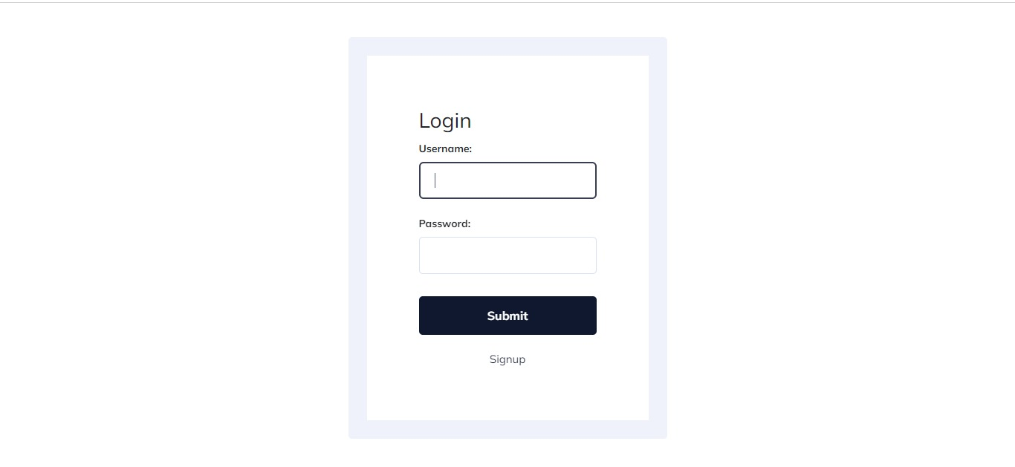
Login Page

Slide 12
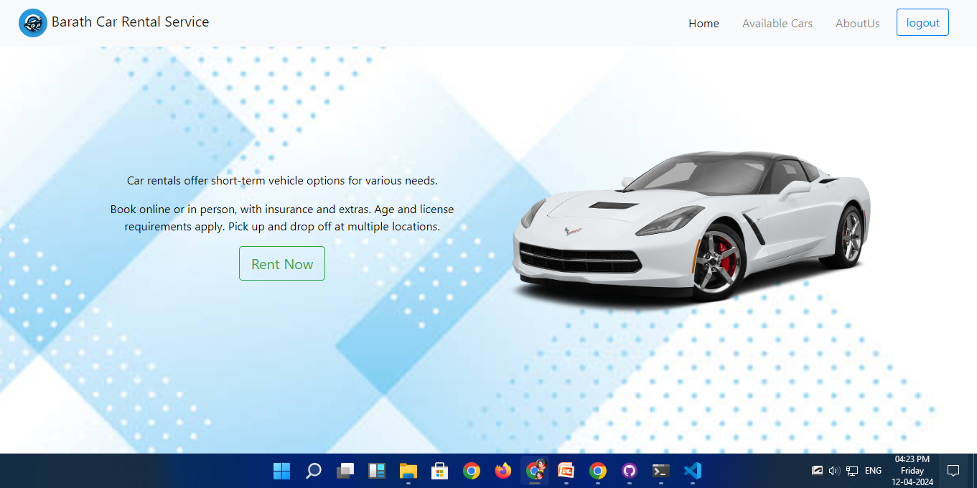
Homepage

Slide 13
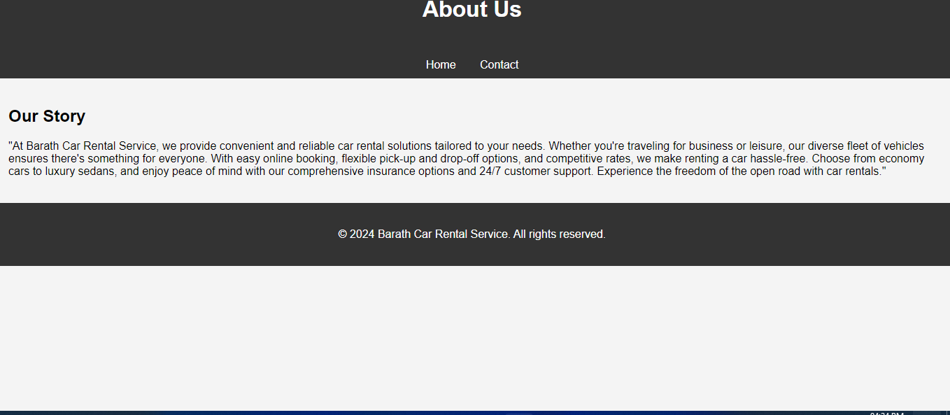
About-Us-Page

Slide 14
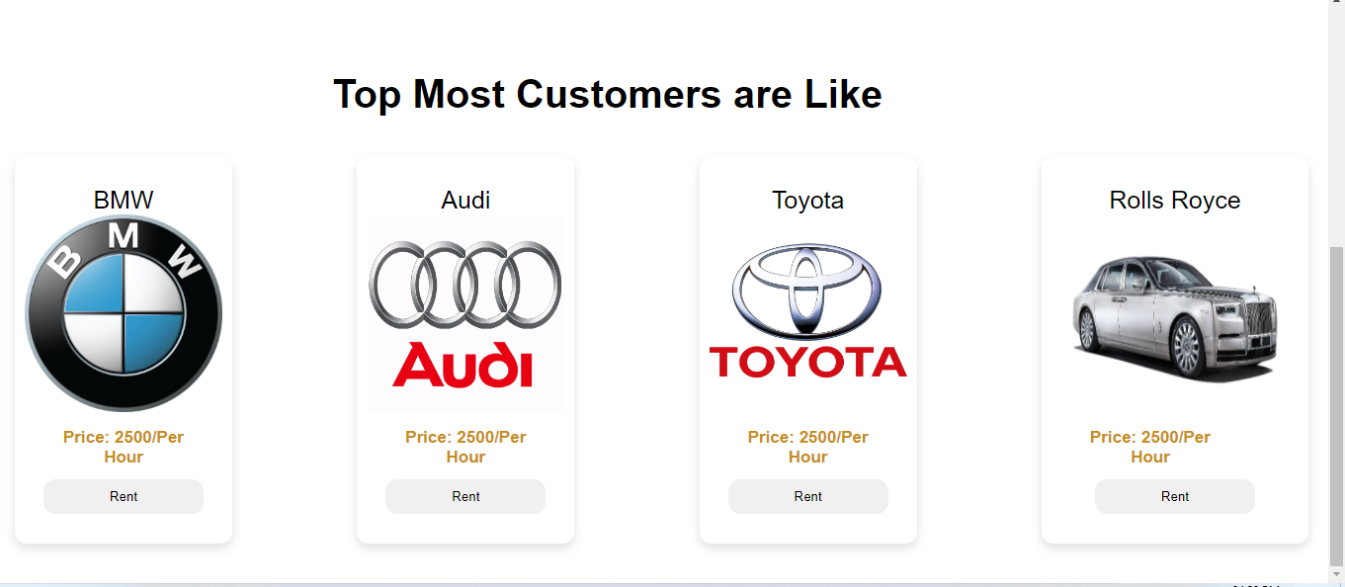
Car -page

Slide 15
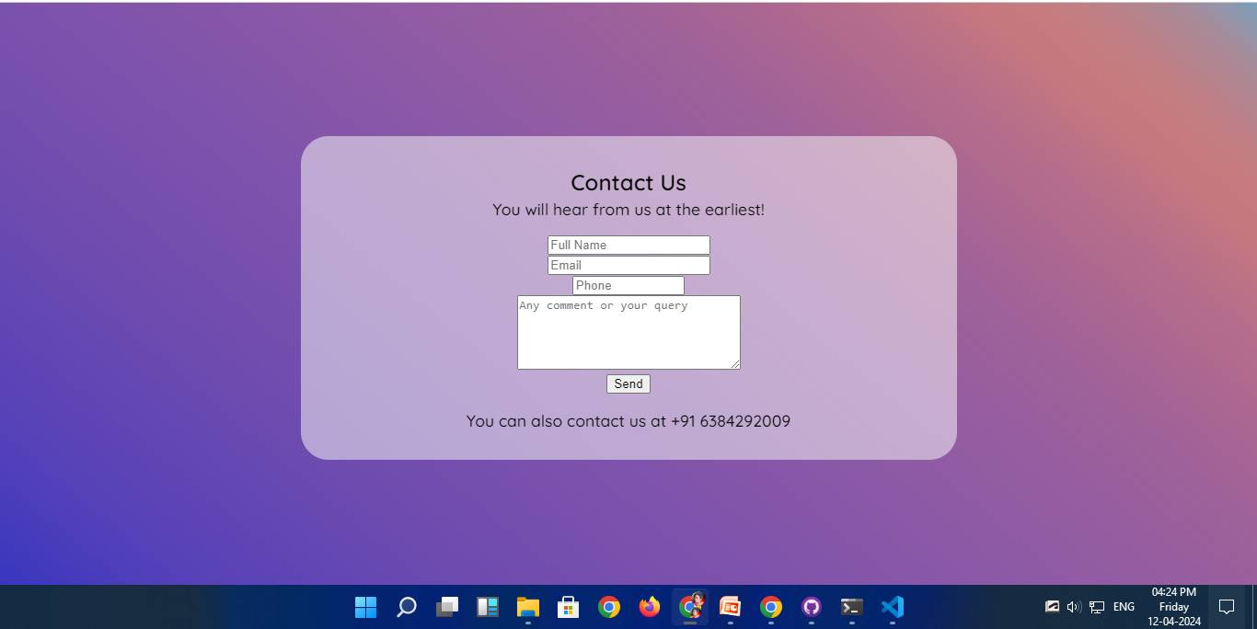
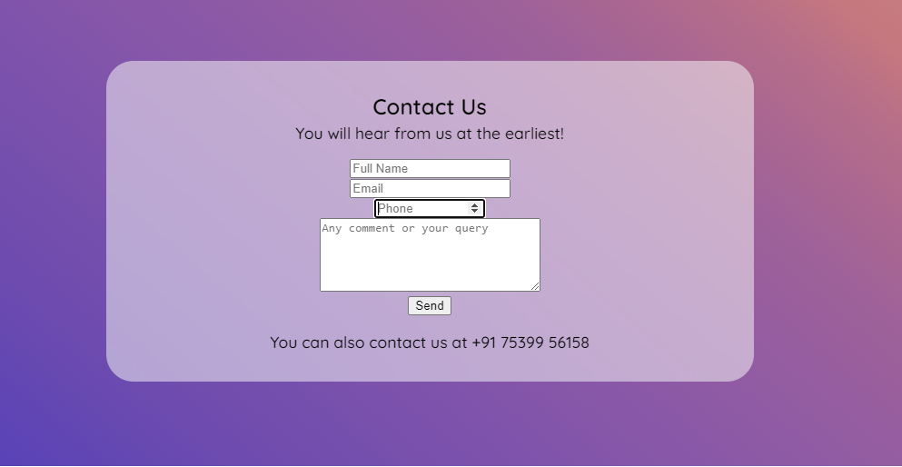
Contact-page

Slide 16
Future Enhancements:
*Integration with External APIs*: Incorporate APIs for additional features like location-based services, vehicle tracking, or weather updates to enhance user experience.
*Advanced Analytics*: Implement advanced analytics tools to provide insights into rental trends, customer behavior, and inventory management, enabling data-driven decision-making.
*AI-Powered Recommendations*: Utilize artificial intelligence to provide personalized recommendations for customers based on their past bookings and preferences.

Slide 17
Conclusion
In conclusion, the car rentals application developed with Django Framework presents a robust and efficient solution for managing the rental process. By leveraging Django's powerful features, we have created a user-friendly platform that streamlines booking, enhances user experience, and improves operational efficiency for rental agencies.Through secure authentication, dynamic inventory management, seamless booking capabilities, and integration with payment gateways, the application provides a comprehensive solution for both customers and rental agencies.
Source :

Slide 18
Thank You!
Notes:
Thank You !!

